Slide 1
Step 2 - Project selection: bug tracker
Author: Dmitry Landy
Date: 24 January 2021

Slide 2
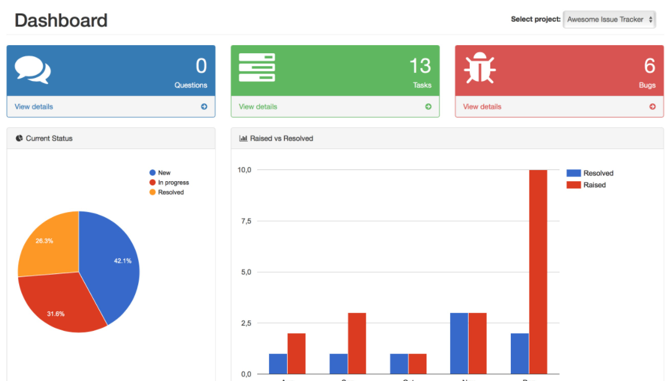
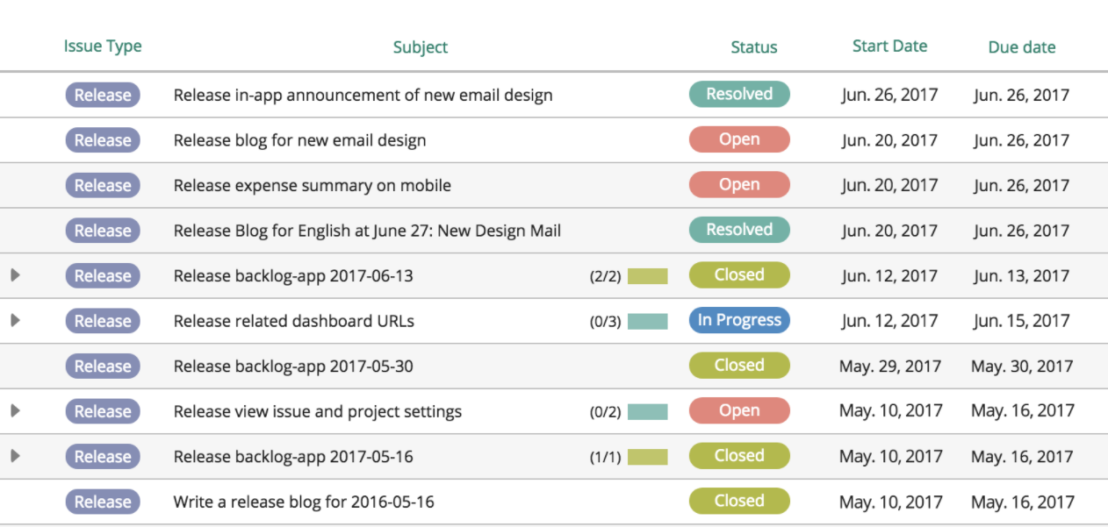
introduction
Bug Tracker: Management application for trouble tickets
FEATURES
Settings/profile screen
Add and edit trouble tickets
Search/sort function
Fully functional UI
Registration Process
Login Screen
Demo Users
Multiple Pages
homepage, current tickets, history, etc.
Notes:
Image Top: issue-tracker_713069_full.png (2880×1800) (alternativeto.net)
Image Bottom: bug-tracking-1.png (1844×806) (backlog.com)

Slide 3
Part 1: data phase
Data Phase: Specifies the kind of data will be in the database.
Areas of consideration:
Users – registration process (usernames, passwords), profile preferences, role, etc.
Projects – project id, description, ticket id’s, etc.
Tickets – subject, ticket id, date, contact info, etc.
DATABASE
USER TABLE
PROJECT TABLE
TICKET TABLE

Slide 4
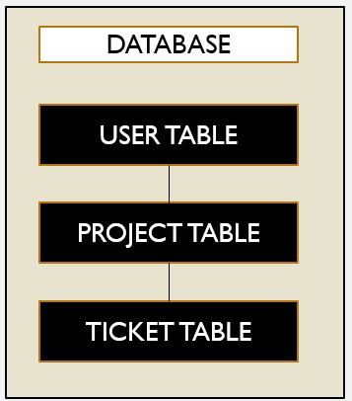
Part 2: programming phase
Programming Phase: Processing the data from the database and modifying it appropriately to provide the user the desired result.
The main processes:
Searching/sorting of the ticket
Adding and editing the tickets
Keeping the statistics of the ticket data for the tables/graphs
Adding/editing user data.
PROCESSES
SEARCHING
EDITING TICKETS
EDITING USERS
PROCESS GRAPHS

Slide 5
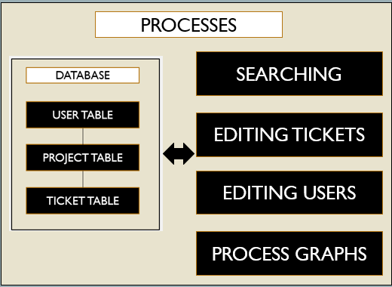
Part 3: interface phase
Interface phase: Involves presenting the application with functional elements (e.g. graphs, buttons, text boxes, etc.).
The following are some areas with elements:
Login page/ Registration elements
Add/edit form for tickets or projects
Search function
Admin role management
Quick tabs
USER INTERFACE
LOGIN PAGE
TICKET FORMS
PROJECT FORMS
ROLE MANAGEMENT

Slide 6

conclusion
Bug Tacker:
Thorough trouble ticket management application
Supports multiple user roles.
Large variety of functions
The development process will focus on three phases:
Data phase: Ensure that the data (e.g. user, ticket) will be stored in the database appropriately.
Programming phase: Implement processing for the data to ensure that it is manipulated properly.
Interface phase: Ensure that each element of the user interface functions properly.

